Slide 1


Developing mediation skills:
Relaying specific information
School Trip

Slide 2
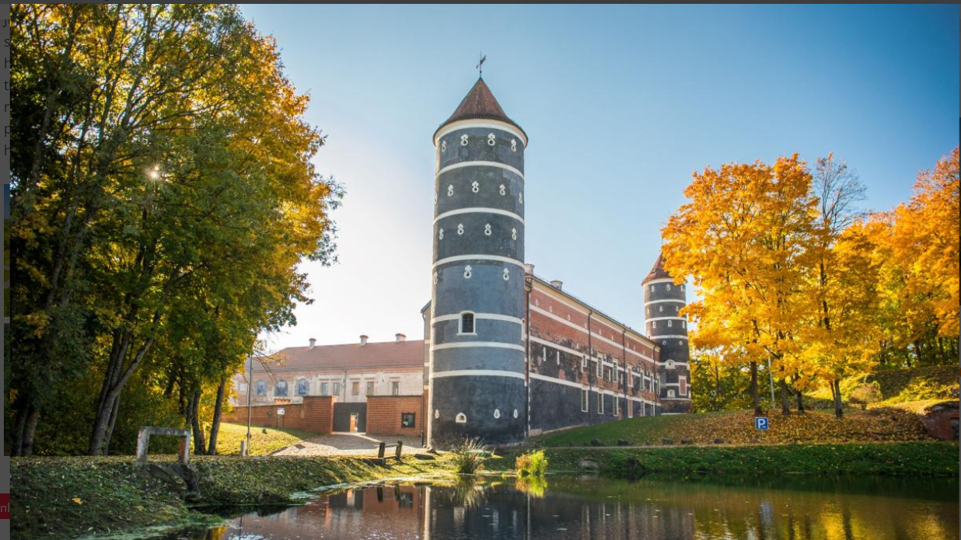
Recommending a School Trip
Notes:
Intro: Use the photo to contextualise the lesson

Slide 3
In our two lessons we’re going to …
Understand mediation
Do an internet search
Use the information to complete a fact sheet on different school trips
Use the fact sheets to discuss and decide on which school trip to recommend
Reflect on our performance
Write a semi-formal email
Notes:
Some teachers prefer to simply instruct and manage the class, others prefer to tell the students what they are going to do it, why, and how. We believe the more informed students are the more they can help the lesson work, and the more they can learn.
The next few slides describe the what, why & how starting with - The “What” we are going to do.

Slide 4
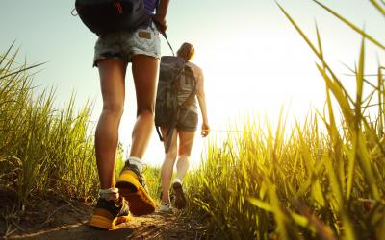
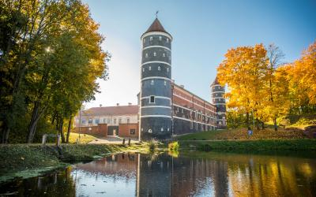
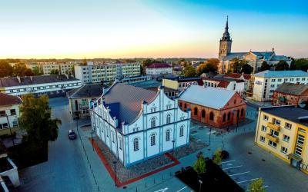

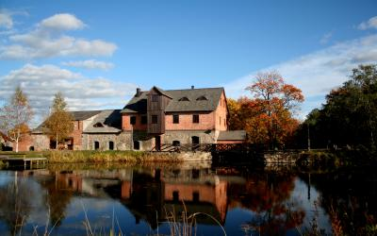
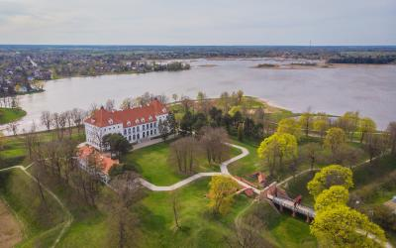
SCENARIO
You are participating in an international project. Your project partners are coming to Lithuania for a project meeting. You are going to spend one day going on a school trip. You have to agree in your group which trip to recommend.
Notes:
What we’re going to do

Slide 5
Developing your mediation skills:
Relaying Specific Information
Can you extract information from a text in Lithuanian and tell others about it in English?
4 | I can do it, easily and very well
3 | I can do it, quite easily and quite well
2 | I can do it, with difficulty but OK
1 | I can do it, with difficulty and badly
0 | I can’t do it./ I’ve never done it. /I don’t know how.
Notes:
“in Lithuanian”
The “Why” we’re going to do it
Use this slide if you want to focus on mediation:
Focus briefly on the title & then on the can-do statement e.g.
Define “mediation”? Look it up in your dictionary/ on your phone
Professional mediation vs. language mediation
Professional mediation is a process for resolving disputes between people or between organisations. Can you think of examples?
Language mediation is helping someone who doesn’t understand or know something to understand. Can you think of examples?

Slide 6

Task 1: Understanding mediation
Listen to these 2 girls sharing information about a coach trip to Kazlų Rūda from the Kelioniu laikas’ web page and complete the table.
DESTINATION | Kazlų Rūda
Duration
Price
What is and isn’t included in the price? | Included | Not included
Itinerary (+ important details)
Meals
Other info
Recommendation & reasons
Notes:
Click on the link to start audio
Note: The audio recording although not loud is authentic. Your students will probably be able to hear other groups recording in the background, which implies students’ recording is standard practice.
And this recording highlights the “mistakes” students typically make when mediating – i.e. they don’t listen to each other
However, if the recording is not sufficiently loud for your class, play it alongside the text on the next slide

Slide 7

Female 1: OK, so another trip is to Kazlų Rūda the oak park. The trip duration is only one day and it costs €9 for students and the park has 6 tracks. You should get your own food because there is no place to buy it and it will be good if you if you wear a sporty clothes because you will be active.
Female 2: So I have also chosen the trip to Kazlų Rūda. However, I have more information to add, so as my partner before mentioned that duration will be one day. The things that would be including in the price is obviously the transport, also, the tour guide services and the excursion programme. Talking about how our trip will go, we will be leaving early in the morning to Kazlų Rūda. After arriving, we will visit the Forest Museum and we'll have a walk on the forest path. During our walk, we will have an opportunity to listen … to listen stories about partisans that spend their time in this forest in the 18th century. After that, we'll have a chance to have a walk in Kazlų Rūda City Park and hear stories about the place name and how it was created and what does it mean. After that we will visit Rimvydas Žigaitis School of Arts in Kazlų Rūda, obviously and after that we‘ll have a chance to visit the Kazlų Rūda Region Museum exposition. And that's all. Yeah.
Notes:
Click on the link to start audio

Slide 8
DESTINATION | Kazlų Rūda
Duration | 1 day
Price | €9
What is and isn’t included in the price? | Included | Not included
 | transport tour guide services excursion programme | meals
Itinerary (+ important details) | leaving early in the morning visit the Forest Museum walk on the forest path (hear about 18th century partisans, how the place got its name) visit Rimvydas Žigaitis School of Arts visit the Kazlų Rūda Region Museum exposition
Meals | bring your own food, you can’t buy it anywhere
Recommendation & reasons | No reasons given

Slide 9
DESTINATION | Kazlų Rūda
Duration | 1 day
Price | €49
What is and isn’t included in the price? | Included | Not included
 | transport tour guide services excursions programme | local guides €10 p.p. educational activities €10 p.p.
Itinerary (+ important details) | Leaving early in the morning. Trip to Kazlų Rūda in Lithuania's third-largest forest. Forest Museum: learn about natural resources, hunting, forestry, local flora and fauna. A walk in the forest - solve the mystery of the town's name "Kazlų Rūda." Visit to city park to see diverse bird population and explore the city's symbols. Educational activities at Kazlų Rūda's Rimvydas Žigaitis School of Arts (create colourful "emotion maps," make unique postcards, create tattoos with China ink and more). Visit to the interactive museum, learn the story of the town and main landmarks.
Meals | Bring your own food. You can’t buy it anywhere

Slide 10



Analysis
How complete and correct was the information
How well did they convey the info? Confidently, clearly, fluently, and accurately?
How did they help others understand? How did they know they had understood?
Most of the information included
Missing: local guides @ €10 P.P.; Educational activities @ €10 P.P.;
3rd largest forest; visit city park
Wrong info: price €49, not €9
Easy to understand
Good, natural fluency
Accurate, no significant errors
No interaction
No evidence of others listening
No evidence of girls’ checking if the others have understood
Notes:
They didn’t mediate the text.
How could they?
They were concentrating on the information and not on the understanding –

Slide 11



Mediation is interactive
Language
Mediation
She can understand
the text.
He can’t understand the text without her. She helps him understand. It is an interactive process.
She can help him by ….
He can help her to help him by ….
Notes:
What is the language skill here? Reading for information & the 2 girls showed that they can read and extract specific, relevant information from a text
What is the communicative skill? Mediation. She bridges the gap between him and the text. It is an information gap. The “problem” is that the 2 girls are more focussed on the information they have to share than on whether their listeners are understanding or even listening (in these activities students aren’t listening, they’re just waiting their turn.
How can she help him understand?
Change her approach:
1. rather than a sustained monologue, she sets up a dialogue by asking him to ask her for the info he needs e.g.
Her: I’ve read about Kazlu Ruda, what would you like to know?
Him: How much does it cost?
Her: €49
Him: what does the price include? etc.
He could / should make notes of her answers
She can signpost e.g. price. It’s €49. For €49 you get: …
What else can she do?
How can he help her to help him? (because she’s concentrating on remembering her info)
He could listen actively e.g. nodding, making sounds to show he is listening. He could echo, recap, summarise, ask questions to show that or what he’s understood.
He could turn it into a Q & A session
He could / should make notes

Slide 12

Literatų Žemaitija
Panemunė Castle Road
Basketball Museum in Joniškis
Sweet Šiauliai and
city stories
By bus in Lithuania: trips for schoolchildren
Notes:
Note: read slide 1 and edit this slide accordingly.
What we are going to do
Highlight the 4 potential trips but do not ask them to start yet – you’re going to cover the “why” first

Slide 13
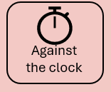
Task 2: Create a fact sheet
A. Literary Žemaitija
B. Panemunė Castle Road
C. Sweet Šiauliai and city stories
D. Joniškis Basketball Museum
Working in groups of 4
Brainstorm
what you already know about this destination
what you’d like to know
Go online, read about the school trip and complete the table for discussion
Notes:
Organise class for cross-grouping
Task 1: students in groups of 4; each group assigned a letter A -> D
Set a time limit for completing the table (next slide)
Using timers: use your whiteboard software to set a timer, for the tasks
Or if you don’t have one, download freeware e.g. https://www.countdownkings.com/free-powerpoint-timer/

Slide 14
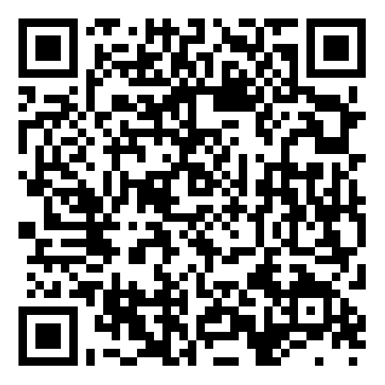
Literary Žemaitija
Panemunė Castle Road
Joniškis Basketball Museum
Sweet Šiauliai and city stories
Notes:
Note: read slide 1 and edit this slide accordingly.
Either ask the students to use the QR code to access the landing page and scroll through to find their trip and complete the table on slide 12 or
hand out photocopies of the “school trip downloaded info” word document, one trip per student in each group. and display slide 12

Slide 15
What do you already know about these trips?
What do you want to know?
DESTINATION
Duration
Price
What is and isn’t included in the price?
Itinerary (+ important details)
Meals
Other info
Recommendation + reasons
Notes:
See word doc for completed tables

Slide 16
Task 3: Deciding which trip to recommend
Switch groups. Form teams of 4, with a student from each of the groups, i.e. one student from group A, one student from group B etc. so that each team has 4 different trips. Choose a name for your team.
Each student in turn uses their notes to mediate the information about their trip, including their recommendations.
The team then discusses and decides which of the 4 trips to recommend and gives their reasons.
Use your phone’s voice recorder and audio record the discussion.
Choose one member of the team to be the reporter.
Reporters: share your team’s recommendation with the whole class and say why you are recommending this trip.

Slide 17
Task 4: Analysis and Reflections
Reflect on your team’s performance. How successful was your team?
Which trip did you recommend?
Did you manage to agree in the time given?
How unanimous was the decision? Did anyone dominate the discussion? Did you need to compromise?
How much was your recommendation based upon the online information and how much was it something else?
What did you learn about collaborating to reach agreement? What would you do differently next time?
Notes:
Next reflections evaluation and follow up.
Many course books and many teachers follow-up tasks like this with focus on language, usually error correction. There is more to it than this:
Task completion, did they complete it in the time allowed? (how well) did they do it i.e. did they discuss and decide or simply share the information?
Mediation: did they monologue it or dialogue it? Did they listening actively listen or simply wait for their turn to speak?
language use. (part of the “how well did they do it) How comprehensible and fluent were they? Did they struggle for vocabulary or expressions? How accurate were they?
Have them discuss their answers to Questions 1 – 4, before going on to question 5, on the next slide

Slide 18
Task 4: Analysis and Reflections
Split the team into pairs and work with a partner.
Reflect on your own performance and that of your partner. How well did you / your partner mediate your / his / her text?
How complete and correct was the information you gave / your partner gave?
How well did you / your partner convey the information? How confidently, clearly, fluently, and accurately?
Was it delivered interactively? How did you / your partner help others understand the text &/or the info?
Notes:
Next reflections evaluation and follow up.
Many course books and many teachers follow-up tasks like this with focus on language, usually error correction. There is more to it than this:
Task completion, did they complete it in the time allowed? (how well) did they do it i.e. did they discuss and decide or simply share the information?
Mediation: did they monologue it or dialogue it? Did they listening actively listen or simply wait for their turn to speak?
language use. (part of the “how well did they do it) How comprehensible and fluent were they? Did they struggle for vocabulary or expressions? How accurate were they?
Have them discuss their answers to Questions 1 – 4, before going on to question 5, on the next slide

Slide 19
Task 4: Analysis and Reflections
Reflect on your own performance and that of your partner. How actively did you / your partner listen?
Did you / your partner understand all the information about the other trips?
What did you / your partner do to show it?
Did you take notes?
What can you do differently to improve your active listening skills?
Notes:
Next reflections evaluation and follow up.
Many course books and many teachers follow-up tasks like this with focus on language, usually error correction. There is more to it than this:
Task completion, did they complete it in the time allowed? (how well) did they do it i.e. did they discuss and decide or simply share the information?
Mediation: did they monologue it or dialogue it? Did they listening actively listen or simply wait for their turn to speak?
language use. (part of the “how well did they do it) How comprehensible and fluent were they? Did they struggle for vocabulary or expressions? How accurate were they?
Have them discuss their answers to Questions 1 – 4, before going on to question 5, on the next slide

Slide 20
Task 4: Analysis and Reflections
Reflect on your English.
Were you / your partner easy to understand? How clear were you? How confident were you? How fluent were you? How much did you hesitate or repeat yourself, or search for the right word or expression?
What problems or difficulties, if any did you / your partner have with language e.g. vocabulary or expressions you needed but you don’t know in English? Make a list of the ones you want to remember.
Did you notice any (typical) language mistakes? Make a list of the ones you want to remember.
What can you do differently to improve your language accuracy or fluency?
Notes:
Next reflections evaluation and follow up.
Many course books and many teachers follow-up tasks like this with focus on language, usually error correction. There is more to it than this:
Task completion, did they complete it in the time allowed? (how well) did they do it i.e. did they discuss and decide or simply share the information?
Mediation: did they monologue it or dialogue it? Did they listening actively listen or simply wait for their turn to speak?
language use. (part of the “how well did they do it) How comprehensible and fluent were they? Did they struggle for vocabulary or expressions? How accurate were they?
Have them discuss their answers to Questions 1 – 4, before going on to question 5, on the next slide

Slide 21
Listen to your discussion and evaluate it
Self-evaluation | Yes 4 | 3 | 2 | 1 | No 0
Success: Did you agree on a recommendation?
Giving information: Did you give specific, relevant information to help the group decide?
Collaboration: Did you help the group reach a decision?
Comprehensibility: Were you easy to understand?
Fluency: Did you flow naturally without stopping, starting again, hesitating, repeating, etc.
Accuracy: Were you grammatically and lexically correct?
Interaction: Did you interact easily?
Total
Notes:
They fill in the grid individually, after listening to the conversation on their phones – using headphones or ear buds. They then discussthe scores with their colleagues.
You could ask them to total their score & divide by 8 to get a score out of 4, and do the same for the group. They can then compare this with their original score, on slide 5 (see next slide).
The actual score is not as important as what they take from it either about the mediation task or about the participation/collaboration, or about the language (see slide following

Slide 22
Task 5: Writing an email
Scenario
You have been delegated to contact your international partners suggesting that a one-day trip be included as part of their programme.
Write the e-mail, in at least 150 words, saying how you arrived at the decision and outlining the itinerary for the trip:
list the places you considered,
describe how you arrived at your choice, and why you chose that trip,
outline the proposed itinerary for the day.

Slide 23
Can you extract and relay specific information from a text to help you to decide where to recommend for a school trip?
4 | I can do it, easily and very well
3 | I can do it, quite easily and quite well
2 | I can do it, with difficulty but successfully
1 | I can do it, with difficulty and badly
0 | I can’t do it. It’s too difficult
Notes:
So, now the pre-test becomes a post-test. Their score may be the same or different, but what is important is what they learned from it.
Not all of them will have learned from it, nor will all of them actively have participated – why is that not OK?

